Slide 1

Google Play Apps Analysis- Non-Technical Presentation
Date: 01-15-2021
Presenter: Xiangning Bu

Slide 2
What are the best market strategies for google play apps(price, size, or category)?
Market popularity :
Installs, rating
Which apps has the most installations, ratings?
Are they the same?
Market strategy :
category, price, size
Which category has most apps in the store?
How about their price and size?
Are they related to each other?
Does the number of installs is affected by price, size, rating and review

Slide 3
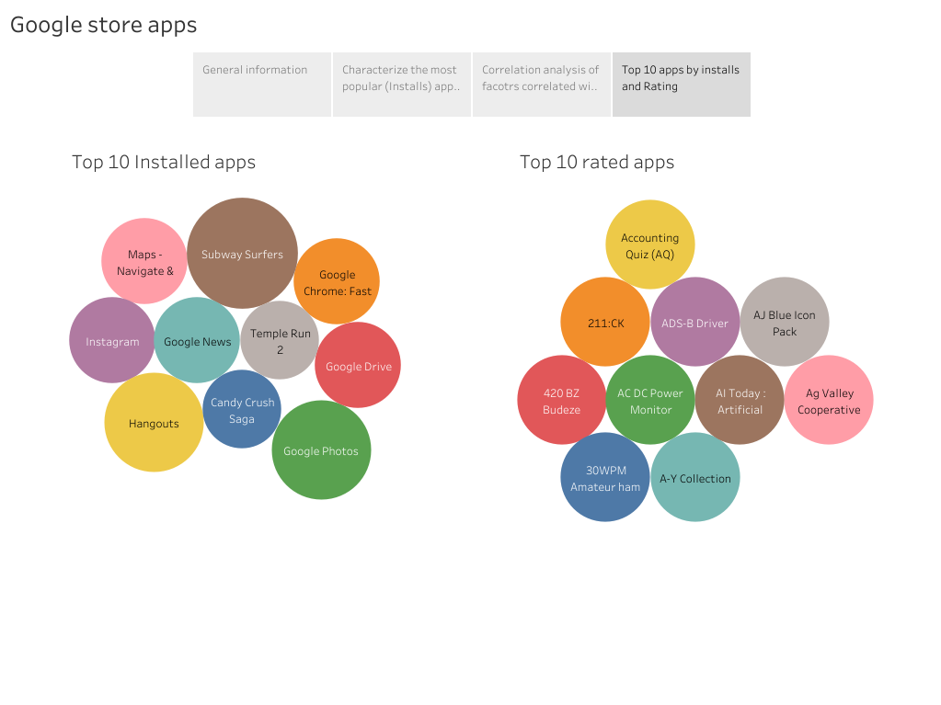
Most installed and rated apps in google play app store. They are totally different.
!=
Source: Kaggle Google Play Store Apps datasheet

Slide 4
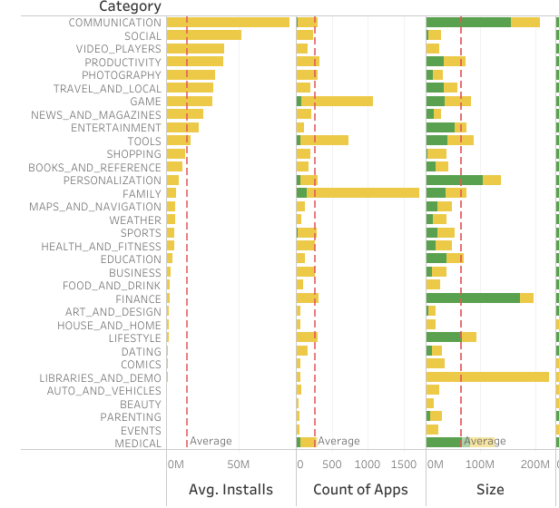
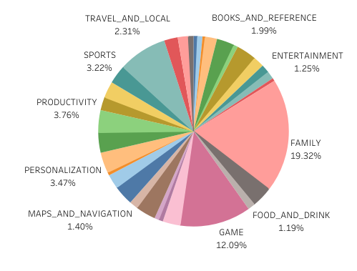
Which category has most apps or installs in the store?
How about their price and size?
Key insights:
Communication apps has highest average installs red box), whole family category has most apps in store (blue box) .
Most of them are free apps.
Family apps have equal size (<50M), while paid communication apps have big size (>100M).
Source: Kaggle Google Play Store Apps datasheet

Slide 5
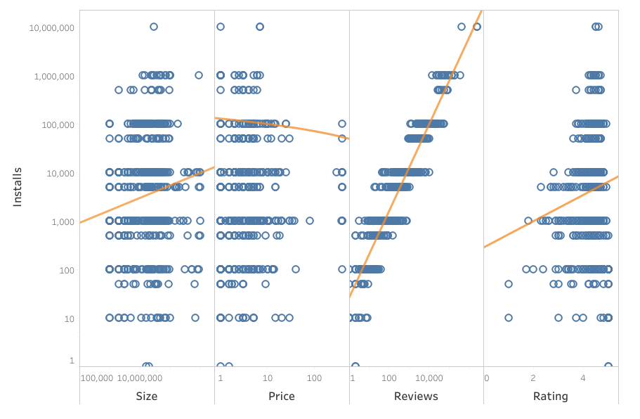
Except price, size, reviews and ratings are positively related to apps installs
Source: Kaggle Google Play Store Apps datasheet

